Slide 1







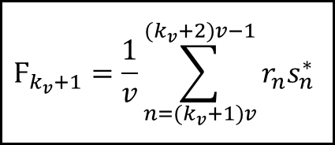

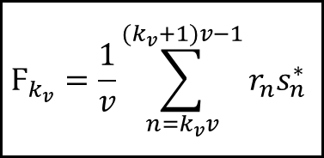



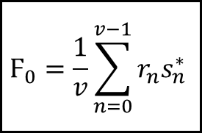


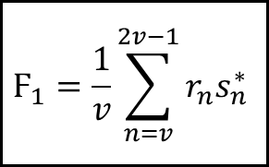







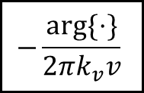

$$r_{0}s_{0}^{∗}$$
$$r_{1}s_{1}^{∗}$$
$$…$$
$$r_{v}s_{v}^{∗}$$
$$…$$
$$r_{k}s_{k}^{∗}$$
$$…$$
$$r_{v+k}s_{v+k}^{∗}$$
$$…$$
$$r_{N−1}s_{N−1}^{∗}$$
$$v$$
$$v$$
$$v$$
$$v$$
coherent integration
$$Ϝ_{0}=\frac{1}{v}\sum_{n=0}^{v−1}{r_{n}s_{n}^{∗}}$$
$$Ϝ_{1}=\frac{1}{v}\sum_{n=v}^{2v−1}{r_{n}s_{n}^{∗}}$$
$$Ϝ_{k_{v}}=\frac{1}{v}\sum_{n=k_{v}v}^{{(k}_{v}+1)v−1}{r_{n}s_{n}^{∗}}$$
$$Ϝ_{k_{v}+1}=\frac{1}{v}\sum_{n={(k}_{v}+1)v}^{{(k}_{v}+2)v−1}{r_{n}s_{n}^{∗}}$$
$$…$$
$…$…
$${\left(∙\right)}^{∗}$$
$${\left(∙\right)}^{∗}$$
$…$…
$…$…
$$∑$$
$$−\frac{arg⁡\{⋅\}}{2πk_{v}v}$$
The block-$v$ SL estimator

